Slide 1

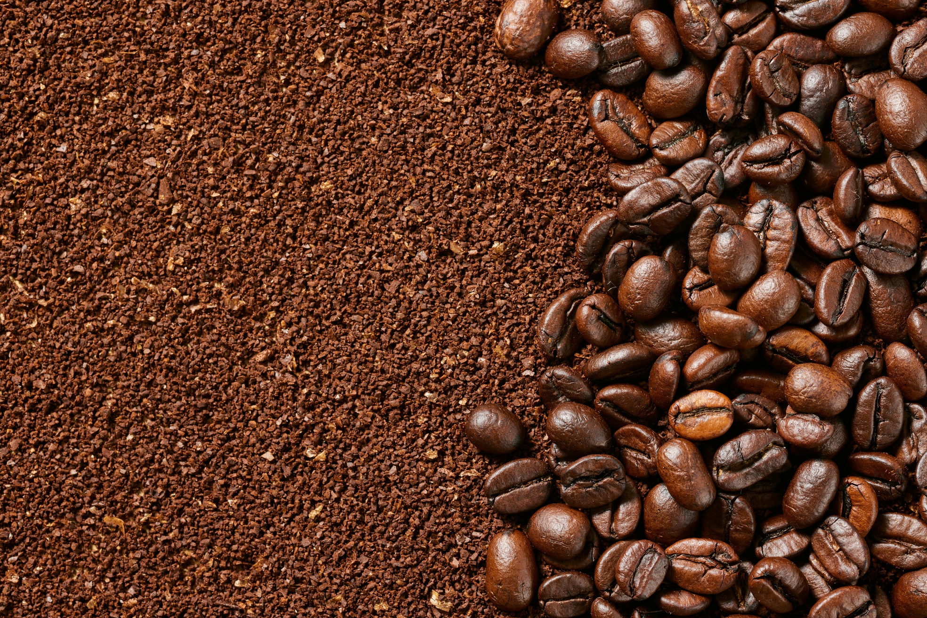





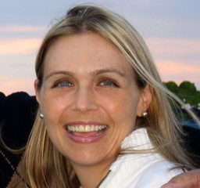


Brewing Connections
Join us for an exquisite coffee tasting event featuring the renowned author Maria Amalia Robbin, celebrated for her book, La Amalia 1888. This unique experience will take place at Yellow Rooster Coffee Imports. The event serves as a fundraiser for the Tampa-Barranquilla Sister Cities initiative, with
Maria Amalia Robbin
proceeds benefiting three deserving charities alongside Tampa Sister Cities - Barranquilla.
December 13, 2025
9 a.m. to 11 a.m
Guests
$20
Supporter
$50
Sponsor
$100
1920 Cafe Ybor City
1920 E. 7th Ave. Tampa, FL 33605

